Slide 1
NLP

Slide 2
Introduction to NLP
Statistical POS Tagging

Slide 3
Part of Speech Tagging Methods
Rule-based
Stochastic
HMM (generative)
Maximum Entropy MM (discriminative)
Transformation-based

Slide 4
HMM-based POS Tagging
Find tag sequence that maximizes the probability formula
P(word|tag) * P(tag|previous n tags)
A bigram-based HMM tagger chooses the tag t_{i} for word w_{i} that is most probable given the previous tag t_{i-1} and the current word w_{i}:
t_{i} = argmax_{j} P(t_{j}|t_{i-1},w_{i})
t_{i} = argmax_{j} P(t_{j}|t_{i-1})P(w_{i}|t_{j}) : HMM equation for a single tag

Slide 5
HMM Tagging
T = argmax P(T|W)
where T=t₁,t₂,…,t_{n}
By Bayes’ theorem
P(T|W) = P(T)P(W|T)/P(W)
Thus we are attempting to choose the sequence of tags that maximizes the RHS of the equation
P(W) can be ignored
P(T) is called the prior, P(W|T) is called the likelihood.

Slide 6
HMM Tagging
Complete formula
P(T)P(W|T) = ΠP(w_{i}|w₁t₁…w_{i-1}t_{i-1}t_{i})P(t_{i}|t₁…t_{i-2}t_{i-1})
Simplification 1:
P(W|T) = ΠP(w_{i}|t_{i})
Simplification 2:
P(T)= ΠP(t_{i}|t_{i-1})
Bigram approximation
T = argmax P(T|W) = argmax ΠP(w_{i}|t_{i}) P(t_{i}|t_{i-1})

Slide 7
Example
The/DT rich/JJ like/VBP to/TO travel/VB ./.

Slide 8
Example
DT
NN
VBP
TO
NN
.
The
rich
like
to
travel
.
DT
NN
VBP
TO
VB
.
The
rich
like
to
travel
.

Slide 9
Maximum Likelihood Estimates
Transitions
P(NN|JJ) = C(JJ,NN)/C(JJ) = 22301/89401 = .249
Emissions
P(this|DT) = C(DT,this)/C(DT) = 7037/103687 = .068

Slide 10
Evaluating Taggers
Data set
Training set
Development set
Test set
Tagging accuracy
how many tags right

Slide 11
HMM POS Results
Assigning each word its most likely tag: 90%
Trigram HMM: 95% (55% on unknown words)
Tuned HMM (Brants 1998): 96.2% (86.0%)
SOTA (Bi-LSTM CRF): 97.5% (89+%)
Numbers thanks to Dan Klein and Greg Durrett

Slide 12
Remaining Errors
Words not seen with that tag in training: 4.5%
Unknown word: 4.5%
Could get right: 16% (needs parsing)
Difficult decision: 20% (“set” = VBP or VBD?)
Underspecified/unclear, gold standard inconsistent/wrong: 58% (e.g., is “discontinued” JJ or VBN)
[Manning 2011]

Slide 13
Notes on POS
New domains
Lower performance
New languages
Morphology matters! Also availability of training data
Distributional clustering
Combine statistics about semantically related words
Example: names of companies
Example: days of the week
Example: animals

Slide 14
Brown Clustering
Words with similar vector representations are clustered together, in an agglomerative (recursive) way
For example, “Monday”, “Tuesday”, etc. may form a new vector “Day of the week”
Published by Brown et al. [1992]

Slide 15
Example
Friday Monday Thursday Wednesday Tuesday Saturday Sunday weekends Sundays
people guys folks fellows CEOs chaps doubters commies unfortunates blokes
down backwards ashore sideways southward northward overboard aloft downwards adrift
water gas coal liquid acid sand carbon steam shale iron
great big vast sudden mere sheer gigantic lifelong scant colossal
American Indian European Japanese German African Catholic Israeli Italian Arab
mother wife father son husband brother daughter sister boss uncle
machine device controller processor CPU printer spindle subsystem compiler plotter
John George James Bob Robert Paul William Jim David Mike
feet miles pounds degrees inches barrels tons acres meters bytes
had hadn't hath would've could've should've must've might've
that tha theat
head body hands eyes voice arm seat eye hair mouth

Slide 16
Example
Input:
this is one document . it has two sentences but the program only cares about spaces .
here is another document . it also has two sentences .
and here is a third document with one sentence .
this document is short .
the dog ran in the park .
the cat was chased by the dog .
the dog chased the cat .
[code by Michael Heilman: https://github.com/mheilman/tan-clustering]

Slide 17
. 1011 9
the 011 7
is 110 4
document 1110 4
dog 000 3
it 101001 2
one 11111 2
sentences 1010111 2
chased 00111 2
two 1010100 2
has 1010110 2
here 111101 2
this 1000 2
cat 0010 2
and 11110010 1
sentence 11110011 1
ran 01011 1
in 0100 1
spaces 10101011011 1
another 1010001 1
cares 101010111 1
also 1010000 1
only 10101011010 1
program 10101011001 1
was 001100 1
park 01010 1
but 10101011000 1
short 1001 1
with 111100001 1
by 001101 1
a 111100000 1
about 10101010 1
third 11110001 1
[code by Michael Heilman]

Slide 18
Notes on POS
British National Corpus
http://www.natcorp.ox.ac.uk/
Tagset sizes
PTB 45, Brown 85, Universal 12, Twitter 25
Dealing with unknown words
Look at features like twoDigitNum, allCaps, initCaps, containsDigitAndSlash (Bikel et al. 1999)

Slide 19
External Link
Jason Eisner’s awesome interactive spreadsheet about learning HMMs
http://cs.jhu.edu/~jason/papers/#eisner-2002-tnlp
http://cs.jhu.edu/~jason/papers/eisner.hmm.xls

Slide 20
Introduction to NLP
Transformation-Based Learning

Slide 21
Transformation Based Learning
Idea: change some labels given specific input patterns
[Brill 1995]
Example
P(NN|sleep) = .9
P(VB|sleep) = .1
Change NN to VB when the previous tag is TO
Types of rules:
The preceding (following) word is tagged z
The word two before (after) is tagged z
One of the two preceding (following) words is tagged z
One of the three preceding (following) words is tagged z
The preceding word is tagged z and the following word is tagged w

Slide 22
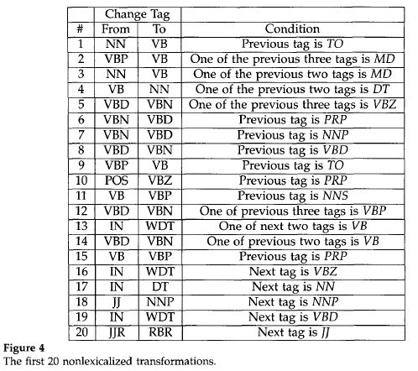
Transformation Based Tagger

Slide 23
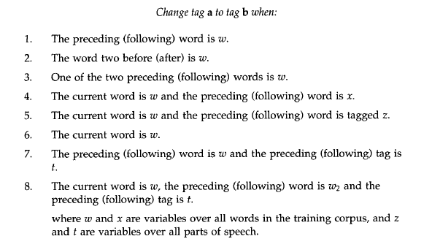
Transformation Based Tagger

Slide 24
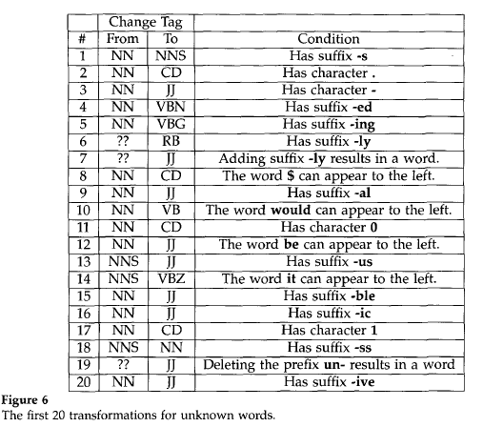
Unknown Words

Slide 25
NLP

